Slide 1
Predicting the Optimum type and location of a restaurant based on demographics

Slide 2
Introduction
The success of a business is affected by various parameters with the demographics and the type of location.
Every Neighborhood is different and has a different demographic which could indicate the number of businesses the neighborhood could sustain.
This project aims to analyze and explore the effect of key demographic factors on the type and number of Restaurants in a neighborhood
The project would be addressed to a startup Restaurant in a location and would like to know the feasibility of establishing a new Restaurant and what type of cuisine or type the restaurant should belong to.

Slide 3
Data Collection
Demographic Data and Income and Housing Data was obtained using the Census Data Portal.
The Geographical Data of the neighborhoods was obtained from New York City Open Datasets. The shapefiles provided give the Name, Area Code, Location and shape of the NTA Areas.
The Data about traffic was obtained from New York Dept. of Transportation.
The data about landmarks in the neighborhoods and the actual Data about the types and number of restaurants in each neighborhood was obtained from the Foursquare API.

Slide 4
Data Processing
The initial cleaning processes finally led to 15 different features and 14 types of targets.
The Data processing steps performed include:
Log Transform
Outlier Removal
PCA to reduce multicollinearity
The feature selection and PCA steps were done dynamically during the learning process to identify their effects on the results.

Slide 5
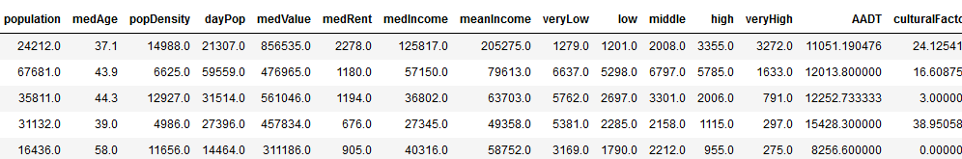
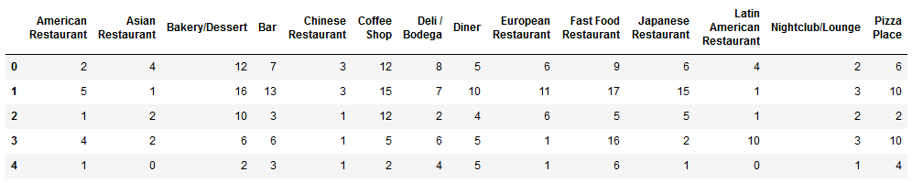
Cleaned Data
Features Dataframe (Top) and Targets Dataframe(Bottom)

Slide 6
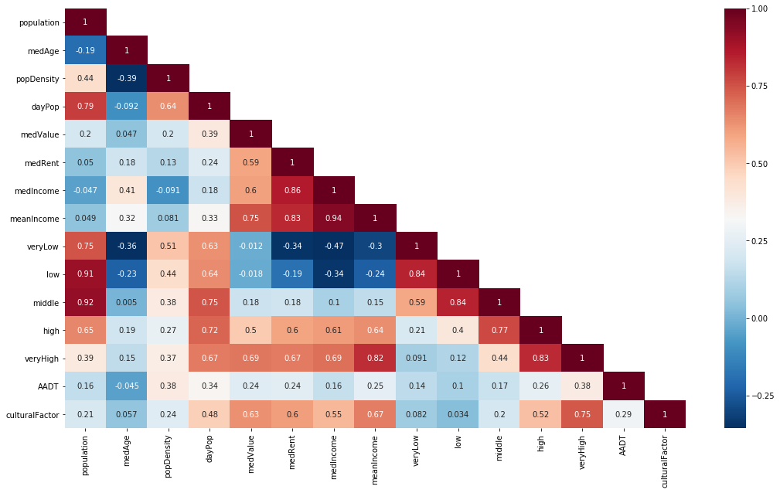
Exploratory Data Analysis
From this heat map, it is observed that some features have a high correlation with each other and could lead to multicollinearity and thus bias the results.
So, these features have to be dropped or treated. Here it was chosen to employ PCA to reduce the dimensionality of collinear features.
Heatmap of correlations of Feature variables with themselves

Slide 7
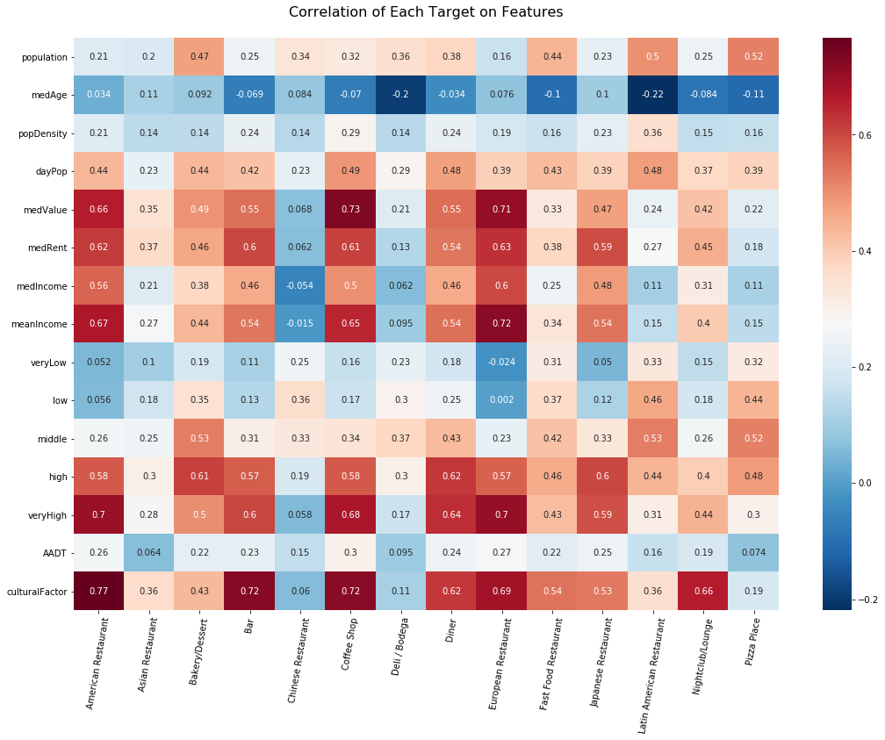
Exploratory Data Analysis
Population and daytime Population affects the presence of Snack Spots.
The median Age of an area generally has a slight negative correlation with the overall presence of restaurants
It is seen that people with higher income eat in high quality American restaurants, European Restaurants and Japanese restaurants
It is seen that the presence of Landmarks and Tourist Attractions greatly increase the presence of Bars and Coffee Shops.
Asian Restaurants, Delis and Pizza places are not highly correlated to any feature which indicates that they are evenly distributed over neighborhoods.

Slide 8
Machine Learning Methodology
Pick a Target
Split the Data into Train/Test Splits
Create Pipelines
Regression Models
Hyper-Parameter Optimization
Bagging the best Regressors
Predict Results
Apply Pre-processing

Slide 9
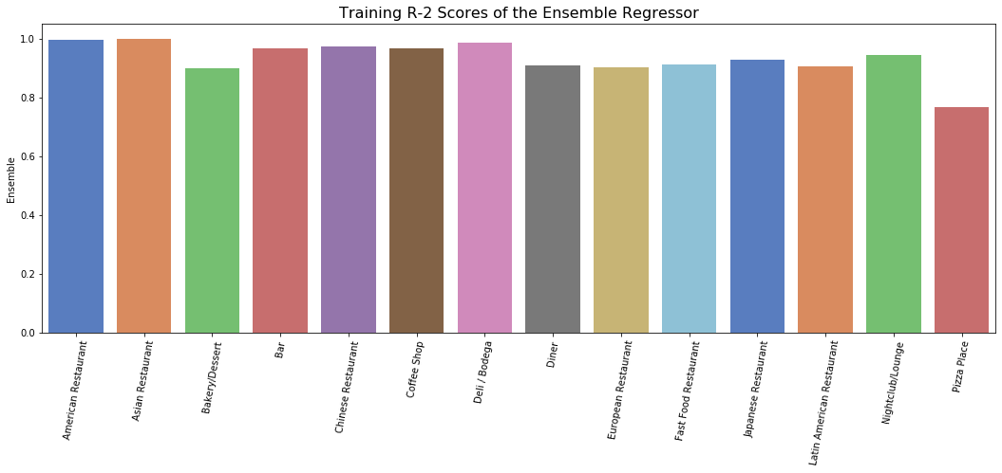
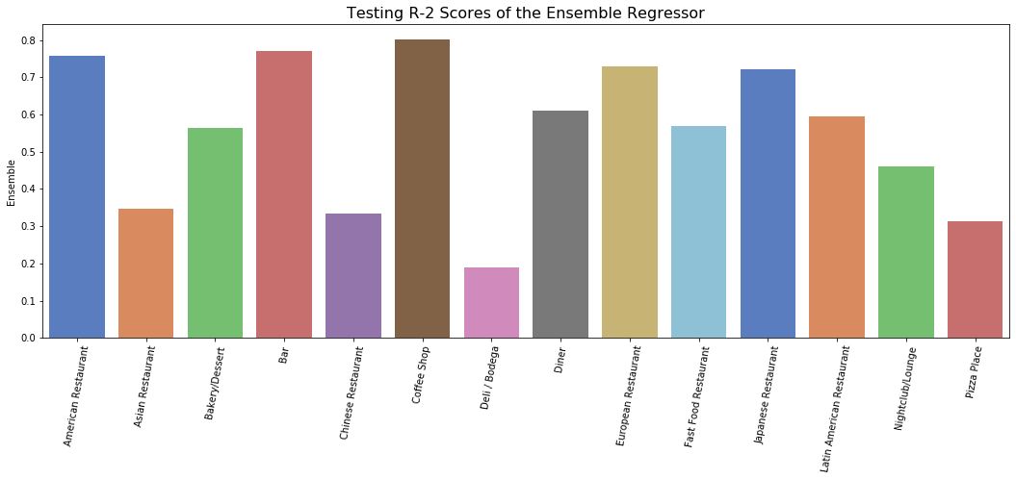
Results – Predictor Performances

Slide 10
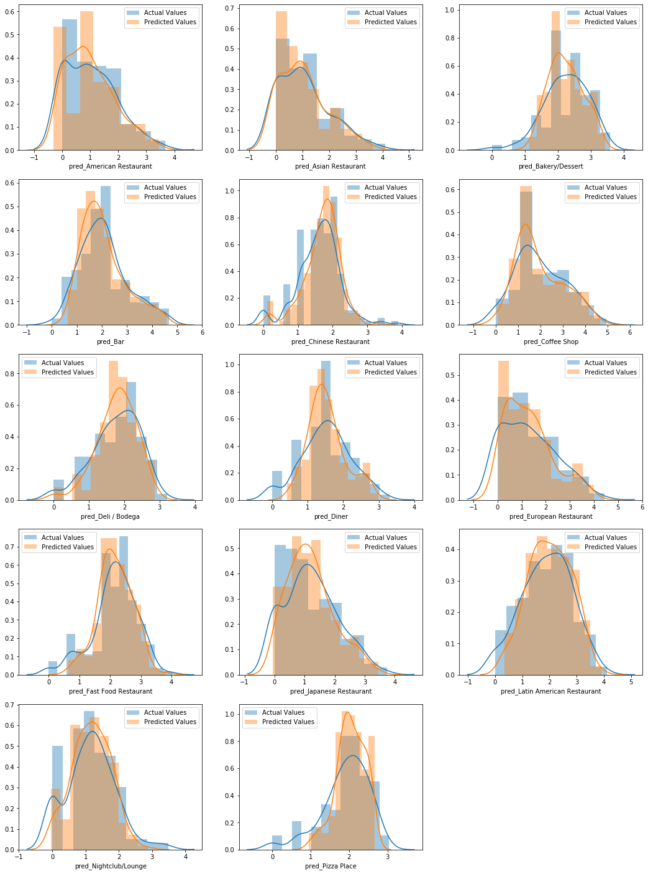
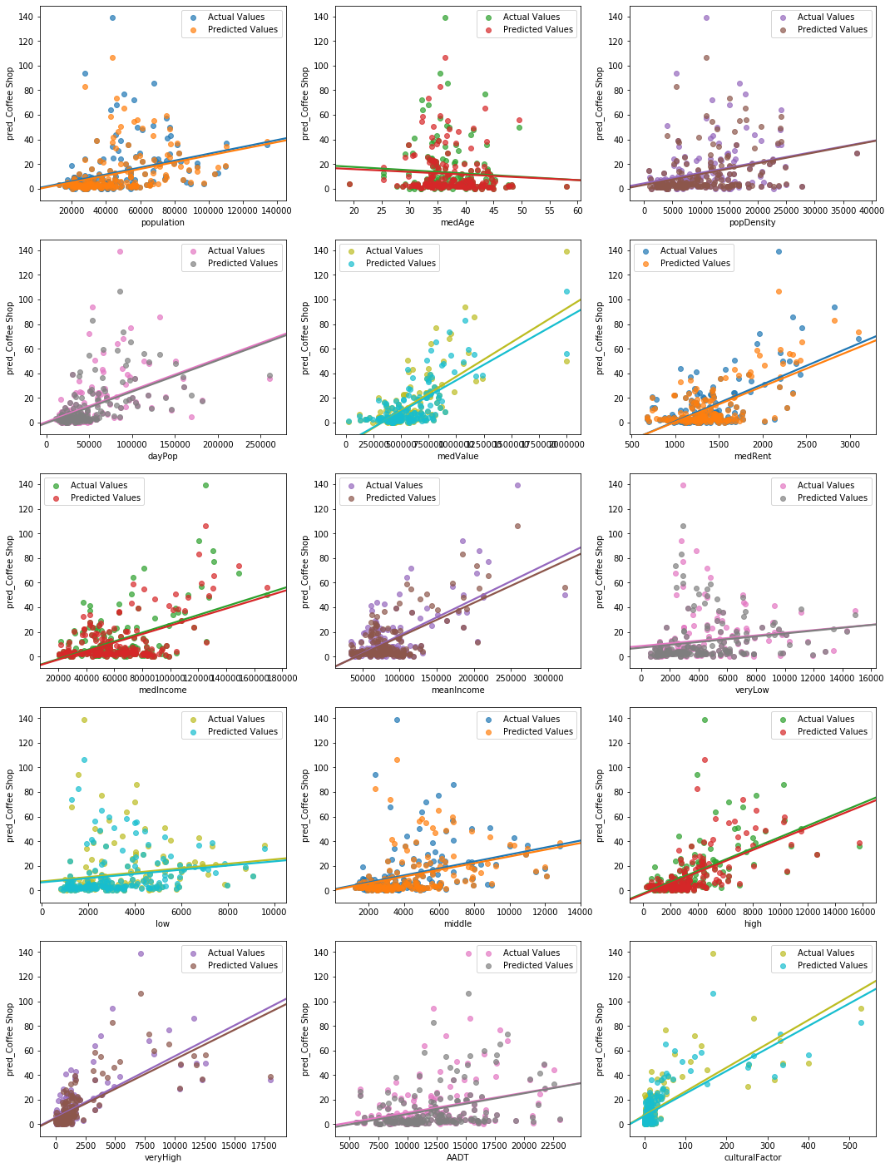
Results – Similarity of Prediction

Slide 11
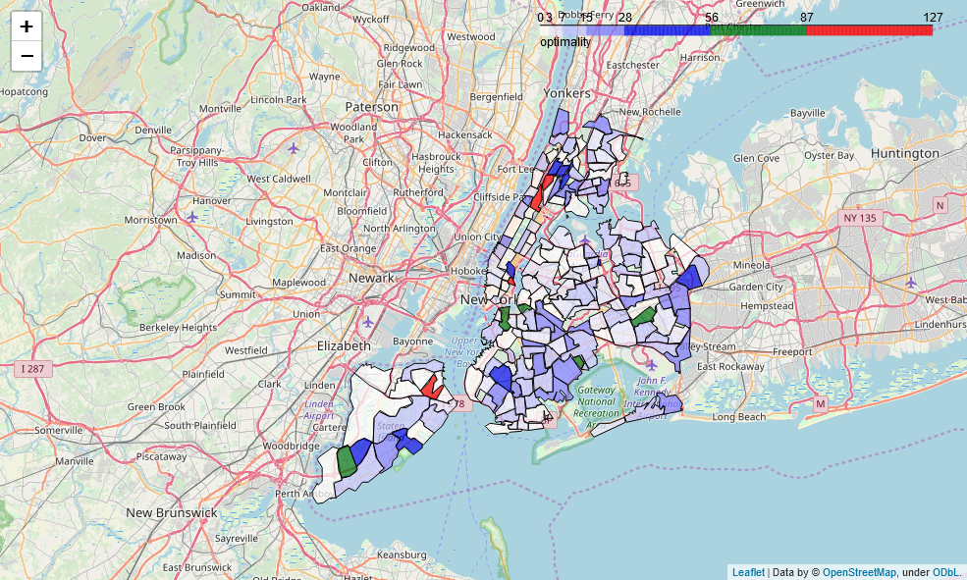
Results – Best Locations of Interest
Visualization showing the most optimum locations to open a Restaurant
(Higher is Better)

Slide 12
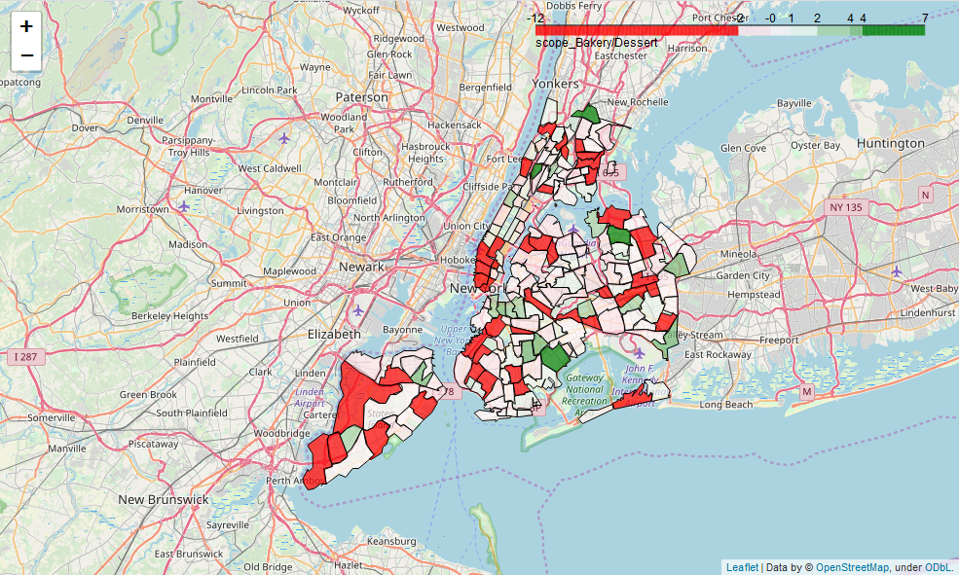
Results – Best Locations based on type of Restaurant
Visualization showing the most optimum locations to open a Bakery or a Dessert Shop
(Greens indicate optimum locations – Reds indicate bad locations – Whites indicate Neutral)

Slide 13
Conclusion
This concept should work for a new demographic where the feasibility is to be assessed and not on the training set itself. But citing, the lack of time, it has been illustrated on the data of New York City itself
The entire concept of the project is solely based upon the fact that New York can be taken as a fully developed city and is at its saturation and the model would predict successfully under cases where the demographic is similar to New York
it should be applicable to at least all the state capitals and big cities like Los Angeles, Chicago and such in the USA, and might even work for cities outside the US.

